Slide 1
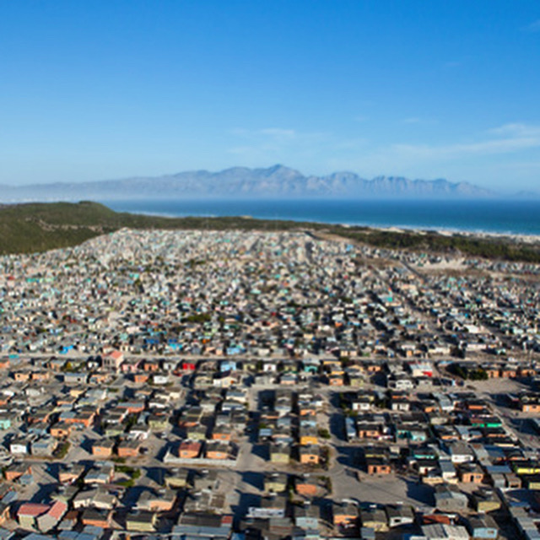
ikhaya lama khaya
a project of iKhayalami - provider of improved houses, upgraded shacks and basic services, located in Khayelitsha, Cape Town
justice begins at home

Slide 2
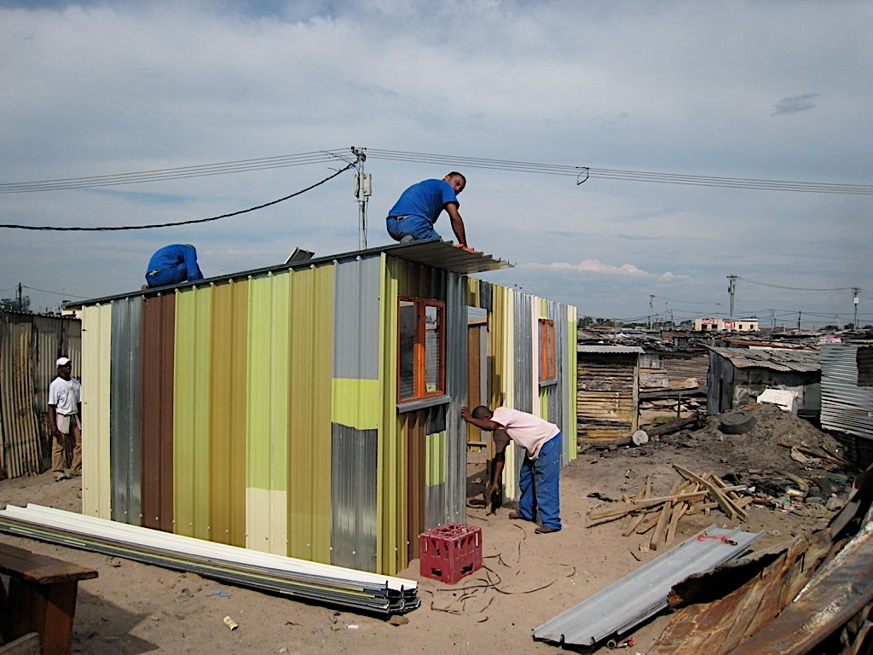
Problem?
121,500
7,500
450,000+
Estimated number of Shack Dwellers in Cape Town
Estimated Average number of units upgraded annually by the Govt
Estimated number of Domestic workers living in shacks
What do you know about the living conditions of your employees?

Slide 3
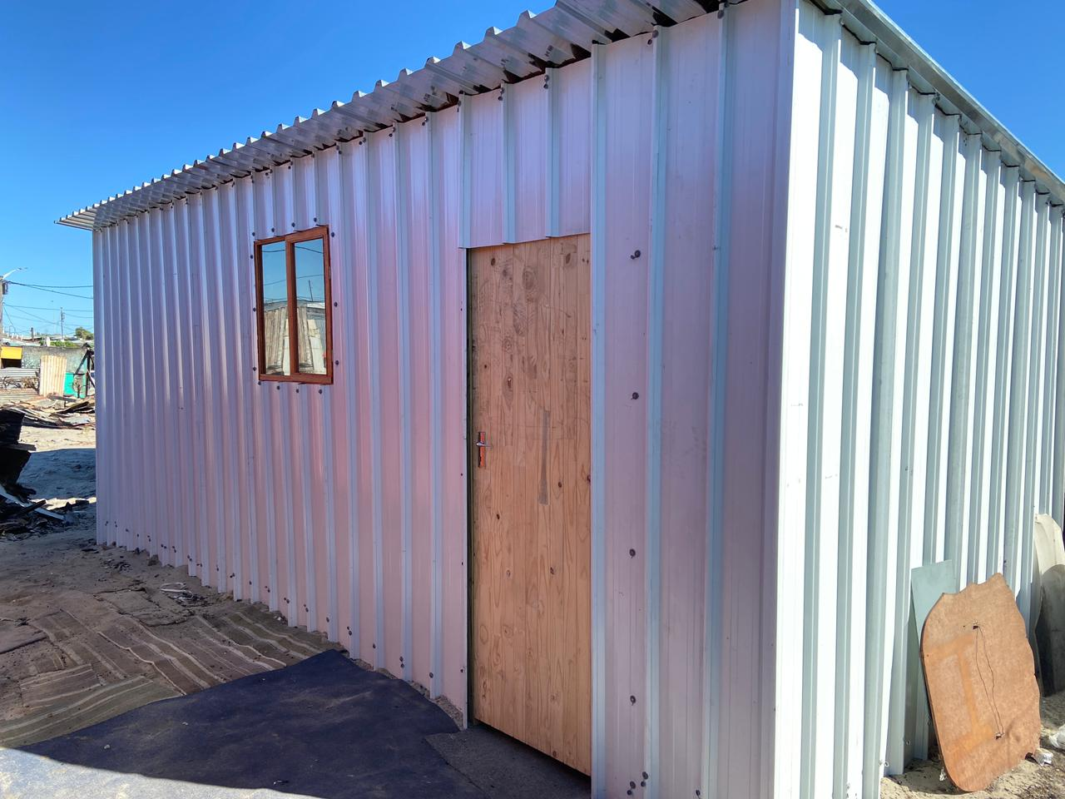
Our Solution
We are a one-stop shop for employers who want to help their workers turn their shacks into decent shelters.
justice begins at home

Slide 4
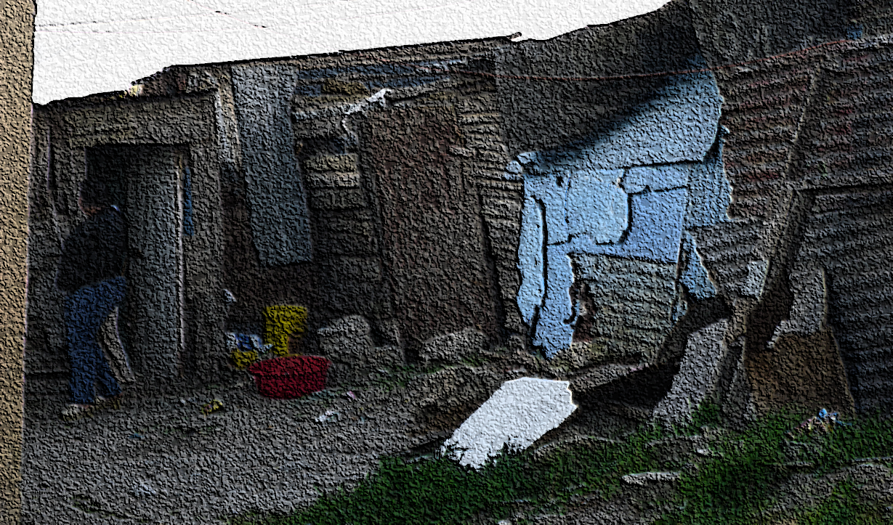
Three Easy Steps
Step 1: Building a Relationship and Assessing Need
We We meet with employers who have expressed an interest in improving the shelters of their domestic workers.
We introduce the employer to our product range – all modular structures made from highly durable, fire and flood resistant materials.
We visit the site, assess the existing structure, take measurements and adapt the modular unit of choice to the situation on the ground.
justice begins at home

Slide 5
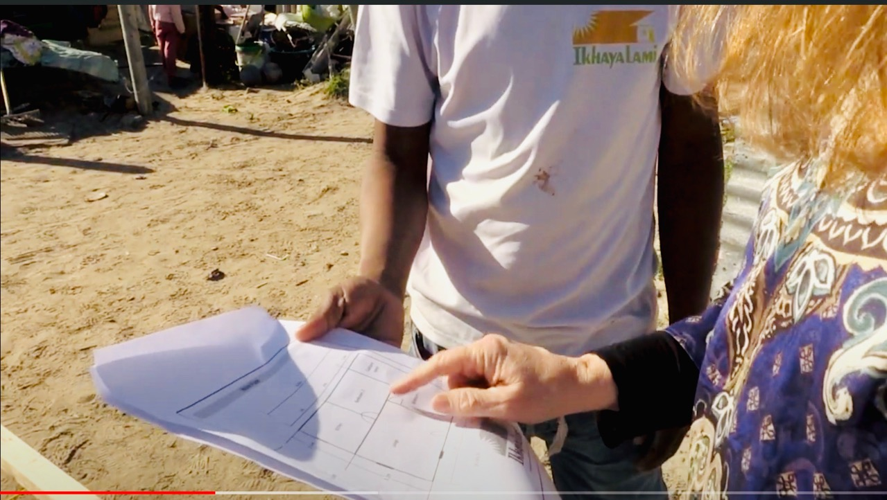
Three Easy Steps
Step 2: Working out the Finances
We We calculate what the build will cost, show our pricing to the clients and conclude an agreement.
If needed the employer can access a loan to to pre-finance the build once a credit check is done.
A legal, binding contract is signed between the parties – iKhaya lama Khaya, the employer and the employee.
justice begins at home

Slide 6
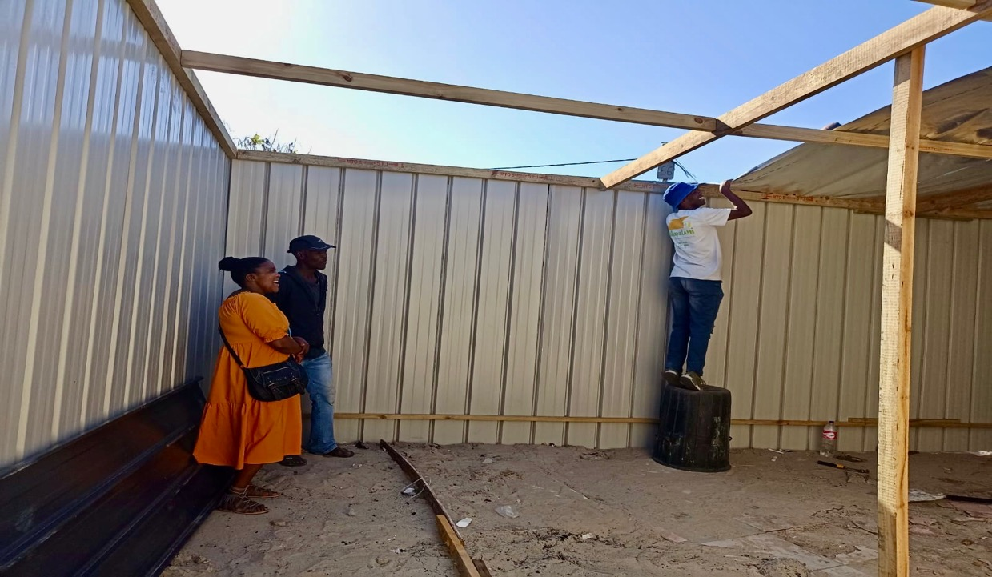
Three Easy Steps
We assemble what we can in our factory and load everything onto one of our trucks.s
Step 3: Building the new shelter
Only then do we begin to dismantle the existing structure. This ensures minimal disruption to the family
The new durable, fire and flood resistant structure is completed within 48 hours
justice begins at home

Slide 7
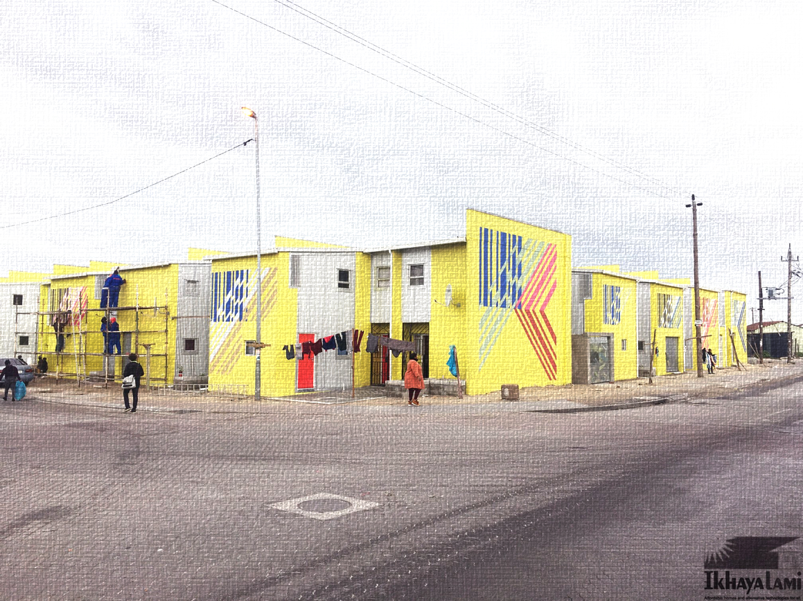
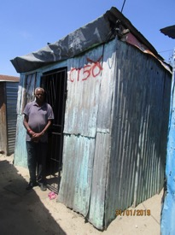
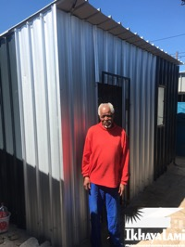
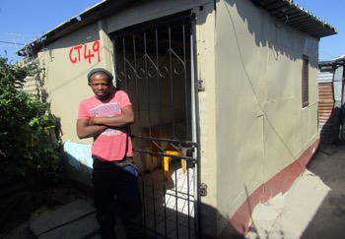
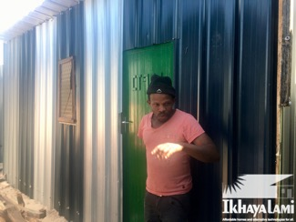
Before & After

Slide 8
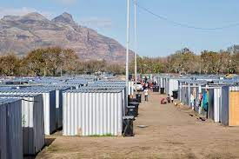
Partners

